Slide 1
Diffusion Model
Xinyang Liu
Xidian University

Slide 2

Demo Images from https://lilianweng.github.io/posts/2021-07-11-diffusion-models/

Slide 3
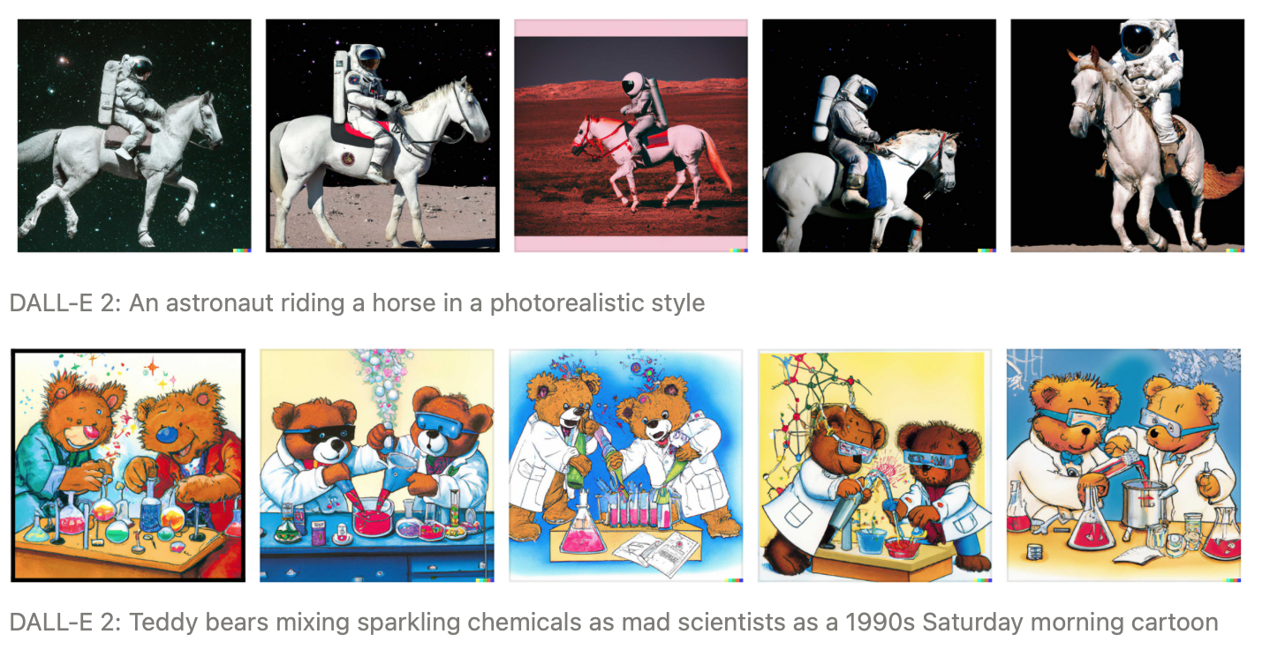
DALL-E 2

Slide 4
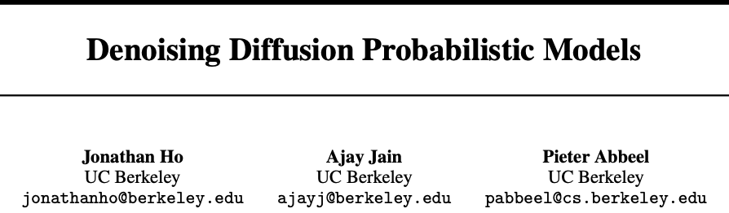
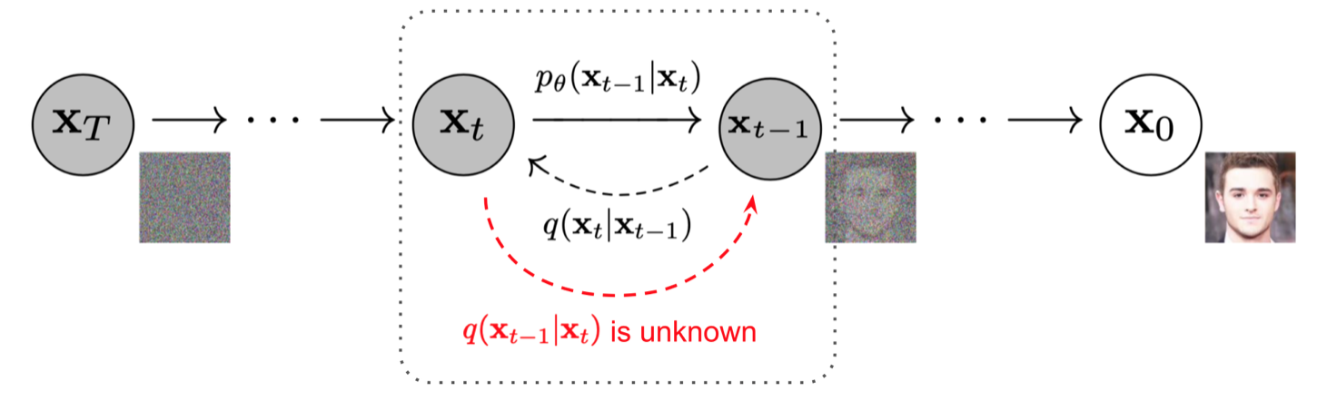
Ho et al. Denoising Diffusion Probabilistic Models (DDPM), NIPS 2020
Notes:
Fdg

Slide 5
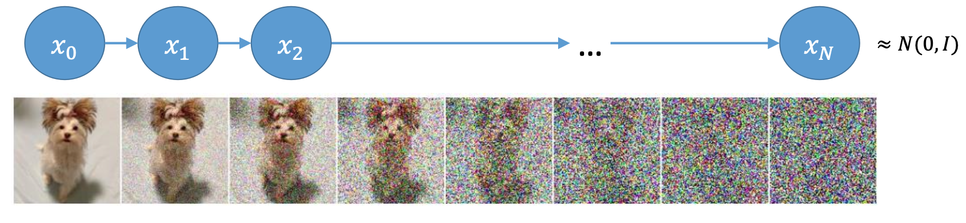
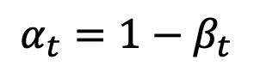
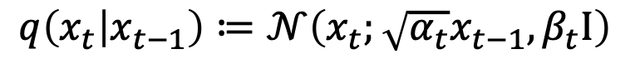
Forward/Diffusion process
Diffusion process gradually injects noise to data
Described by a Markov chain:
$$q\left(x_{0},…,x_{T}\right)=q\left(x_{0}\right)q\left(x_{1} | x_{0}\right)q\left(x_{2} | x_{1}\right)…q\left(x_{T} | x_{T−1}\right)$$
Transition of diffusion:
$$q\left(x_{t} | x_{t−1}\right)≔𝒩\left(x_{t};\sqrt{α_{t}}x_{t−1}, β_{t}I\right)$$
$$α_{t}=1−β_{t}$$
Demo Images from Song et al. Score-based generative modeling through stochastic differential equations, ICLR 2021

Slide 6
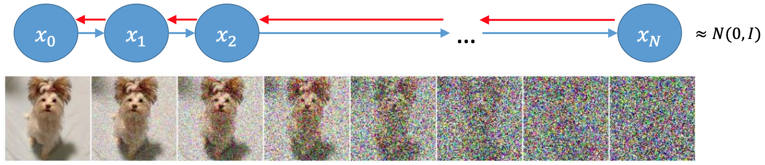
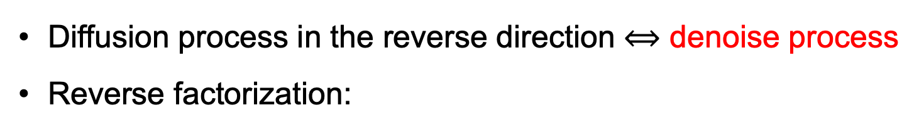
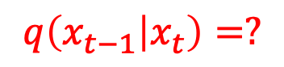
Reverse process
Diffusion process in the reverse direction $⟺$ denoise process
Reverse factorization:
$$q\left(x_{0},…,x_{T}\right)=q\left(x_{0} | x_{1}\right)q\left(x_{1} | x_{2}\right)…q\left(x_{T−1} | x_{T}\right)q\left(x_{T}\right)$$
Transition of reverse:
$$q\left(x_{t−1} | x_{t}\right)=?$$
Diffusion process:
$$q\left(x_{0},…,x_{T}\right)=q\left(x_{0}\right)q\left(x_{1} | x_{0}\right)q\left(x_{2} | x_{1}\right)…q\left(x_{T} | x_{T−1}\right)$$
$$=q\left(x_{0} | x_{1}\right)q\left(x_{1} | x_{2}\right)…q\left(x_{T−1} | x_{T}\right)q\left(x_{T}\right)$$

Slide 7
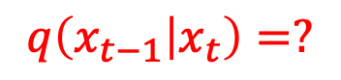
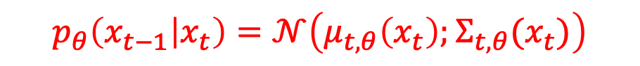
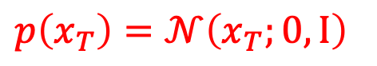
Approximation
Approximate diffusion process in the reverse direction
Model Transition:
$$p_{θ}\left(x_{t−1} | x_{t}\right)=𝒩\left(μ_{t,θ}\left(x_{t}\right);Σ_{t,θ}(x_{t})\right)$$
approximate
Transition of reverse:
$$q\left(x_{t−1} | x_{t}\right)=?$$
Diffusion process:
$$q\left(x_{0},…,x_{T}\right)=q\left(x_{0}\right)q\left(x_{1} | x_{0}\right)q\left(x_{2} | x_{1}\right)…q\left(x_{T} | x_{T−1}\right)$$
$$=q\left(x_{0} | x_{1}\right)q\left(x_{1} | x_{2}\right)…q\left(x_{T−1} | x_{T}\right)q\left(x_{T}\right)$$
The model:
$$p_{θ}\left(x_{0},…,x_{T}\right)=p_{θ}\left(x_{0} | x_{1}\right)p_{θ}\left(x_{1} | x_{2}\right)…p_{θ}\left(x_{T−1} | x_{T}\right)p\left(x_{T}\right)$$
$$p\left(x_{T}\right)=𝒩\left(x_{T};0,I\right)$$

Slide 8

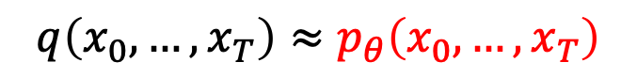
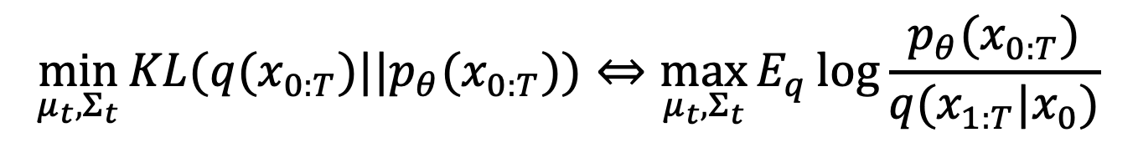
Approximation
We hope
Achieved by minimizing their KL divergence (i.e., maximizing the ELBO)
$$q\left(x_{0},…,x_{T}\right)≈p_{θ}\left(x_{0},…,x_{T}\right)$$
$$p_{θ}\left(x_{t−1} | x_{t}\right)=𝒩\left(μ_{t}\left(x_{t}\right);Σ_{t}(x_{t})\right)$$
min KL
max ELBO
$$\min_{μ_{t},Σ_{t}}{KL(q(x_{0:T})||p_{θ}(x_{0:T}))}⇔\max_{μ_{t},Σ_{t}}{E_{q}\log{\frac{p_{θ}(x_{0:T})}{q(x_{1:T}|x_{0})}}}$$

Slide 9
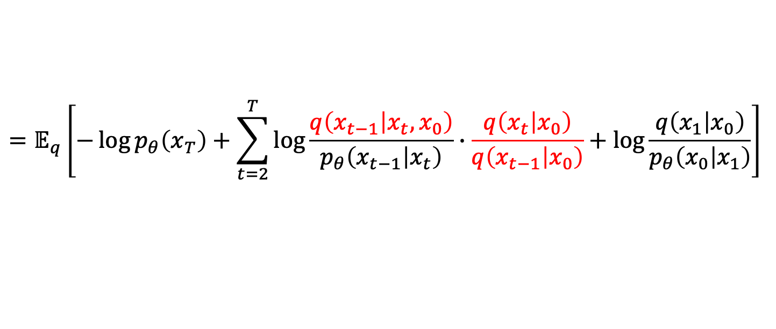
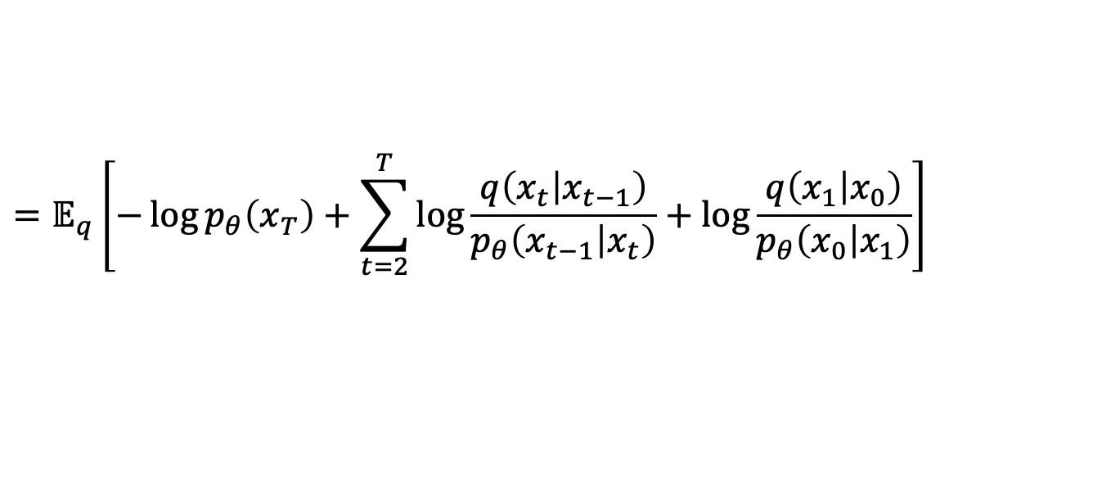
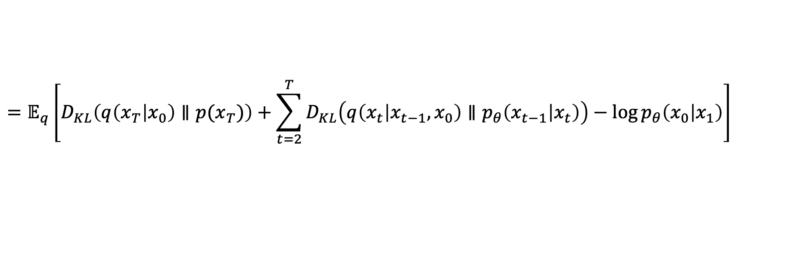
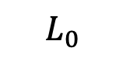
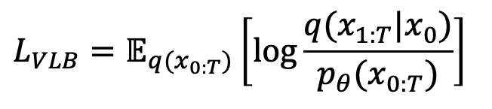
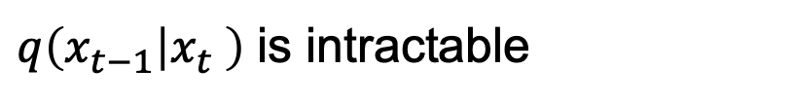
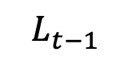
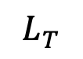
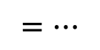
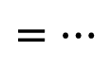
Approximation (simplify)
$q\left(x_{t−1} | x_{t} \right)$ is intractable
$$L_{VLB}=𝔼_{q(x_{0:T})}\left[\log{\frac{q(x_{1:T}|x_{0})}{p_{θ}(x_{0:T})}}\right]$$
Using Bayes’ rule: $q\left(x_{t−1} | x_{t},x_{0}\right)=q\left(x_{t} | x_{t−1},x_{0}\right)\frac{q(x_{t−1}|x_{0})}{q(x_{t}|x_{0})}$
$$=…$$
$$=𝔼_{q}\left[−\log{p_{θ}\left(x_{T}\right)+\sum_{t=2}^{T}{\log{\frac{q\left(x_{t} | x_{t−1}\right)}{p_{θ}\left(x_{t−1} | x_{t}\right)}}}}+\log{\frac{q\left(x_{1} | x_{0}\right)}{p_{θ}\left(x_{0} | x_{1}\right)}}\right]$$
$$=…$$
$$=𝔼_{q}\left[−\log{p_{θ}\left(x_{T}\right)+\sum_{t=2}^{T}{\log{\frac{q\left(x_{t−1} | x_{t},x_{0}\right)}{p_{θ}\left(x_{t−1} | x_{t}\right)}∙\frac{q\left(x_{t} | x_{0}\right)}{q\left(x_{t−1} | x_{0}\right)}}}}+\log{\frac{q\left(x_{1} | x_{0}\right)}{p_{θ}\left(x_{0} | x_{1}\right)}}\right]$$
$$=𝔼_{q}\left[D_{KL}\left(q\left(x_{T} | x_{0}\right)∥p(x_{T})\right)+\sum_{t=2}^{T}{D_{KL}\left(q\left(x_{t} | x_{t−1},x_{0}\right)∥p_{θ}\left(x_{t−1} | x_{t}\right)\right)−\log{p_{θ}\left(x_{0} | x_{1}\right)}}\right]$$
$$L_{T}$$
$$L_{t−1}$$
$$L_{0}$$

Slide 10
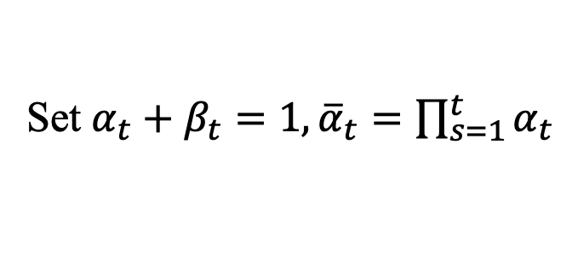
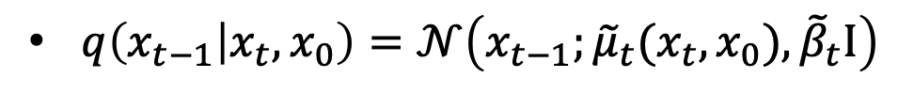
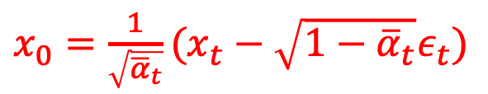
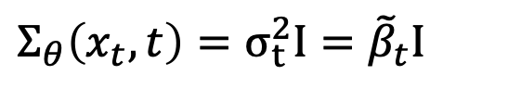
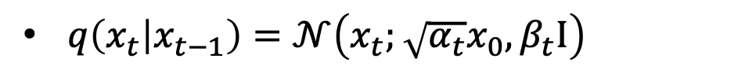
Simple Derivation
$q\left(x_{t} | x_{t−1}\right)=𝒩\left(x_{t};\sqrt{α_{t}}x_{0}, β_{t}I\right)$
Set $α_{t}+β_{t}=1,{\overline{α}}_{t}=\prod_{s=1}^{t}{α_{t}}$
$q\left(x_{t} | x_{0}\right)=𝒩\left(x_{t};\sqrt{{\overline{α}}_{t}}x_{0},(1−{\overline{α}}_{t})I\right)⇔x_{t}=$ $\sqrt{{\overline{α}}_{t}}x_{0}+\sqrt{1−{\overline{α}}_{t}}ε_{t}$
$x_{0}=$ $\frac{1}{\sqrt{{\overline{α}}_{t}}}(x_{t}−\sqrt{1−{\overline{α}}_{t}}ε_{t})$
$q\left(x_{t−1} | x_{t},x_{0}\right)=𝒩\left(x_{t−1};{\tilde{μ}}_{t}(x_{t},x_{0}),{\tilde{β}}_{t}I\right)$
Where ${\tilde{μ}}_{t}\left(x_{t},x_{0}\right)≔\frac{\sqrt{{\overline{α}}_{t−1}}β_{t}}{1−{\overline{α}}_{t}}x_{0}+\frac{\sqrt{{\overline{α}}_{t}}\left(1−{\overline{α}}_{t−1}\right)}{1−{\overline{α}}_{t}}x_{t}$ and ${\tilde{β}}_{t}≔\frac{1−{\overline{α}}_{t−1}}{1−{\overline{α}}_{t}}β_{t}$
$p_{θ}\left(x_{t−1} | x_{t}\right)=𝒩\left({x_{t−1};μ}_{θ}\left(x_{t},t\right);Σ_{θ}(x_{t},t)\right),$
$$Σ_{θ}\left(x_{t},t\right)=σ_{t}^{2}I={\tilde{β}}_{t}I$$

Slide 11
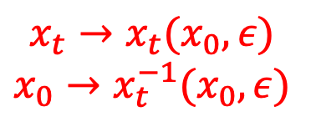
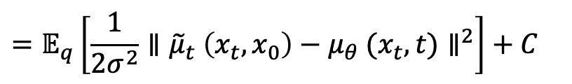
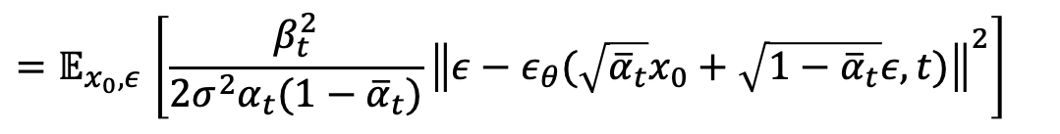
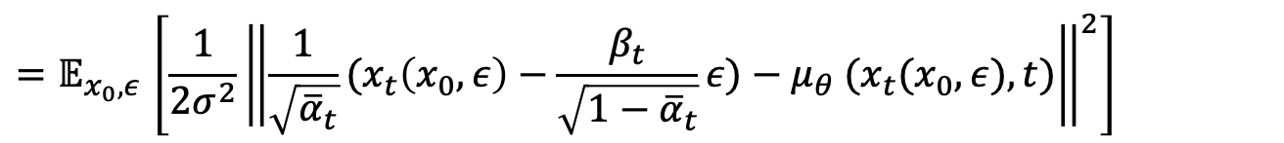
Approximation (simplify)
$${x_{t}→x}_{t}(x_{0},ε)$$
$${x_{0}→x}_{t}^{−1}(x_{0},ε)$$
$${L_{t−1}=D}_{KL}\left(q\left(x_{t} | x_{t−1},x_{0}\right)∥p_{θ}\left(x_{t−1} | x_{t}\right)\right)$$
$$=𝔼_{q}\left[\frac{1}{2σ^{2}}{∥{\tilde{μ}}_{t} \left(x_{t},x_{0}\right)−μ_{θ} (x_{t},t)∥}^{2}\right]+C$$
$$L_{t−1}−C=𝔼_{x_{0},ε}\left[\frac{1}{2σ^{2}}{\left\|{\tilde{μ}}_{t} \left(x_{t}(x_{0},ε),\frac{1}{\sqrt{{\overline{α}}_{t}}}(x_{t}\left(x_{0},ε\right)−\sqrt{1−{\overline{α}}_{t}}ε) \right)−μ_{θ} (x_{t}(x_{0},ε),t)\right\|}^{2}\right]$$
$${=𝔼}_{x_{0},ε}\left[\frac{1}{2σ^{2}}{\left\|\frac{1}{\sqrt{{\overline{α}}_{t}}}(x_{t}\left(x_{0},ε\right)−\frac{β_{t}}{\sqrt{1−{\overline{α}}_{t}}}ε)−μ_{θ} (x_{t}(x_{0},ε),t)\right\|}^{2}\right]$$
$${=𝔼}_{x_{0},ε}\left[\frac{β_{t}^{2}}{2σ^{2}α_{t}(1−{\overline{α}}_{t})}{\left\|ε−ε_{θ}(\sqrt{{\overline{α}}_{t}}x_{0}+\sqrt{1−{\overline{α}}_{t}}ε,t)\right\|}^{2}\right]$$
$$L_{simple}(θ){=𝔼}_{{t,x}_{0},ε}\left[{\left\|ε−ε_{θ}(\sqrt{{\overline{α}}_{t}}x_{0}+\sqrt{1−{\overline{α}}_{t}}ε,t)\right\|}^{2}\right]$$

Slide 12
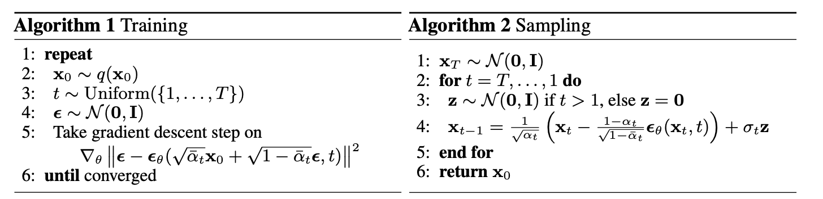
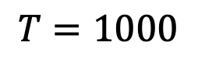
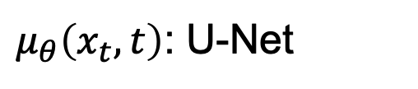
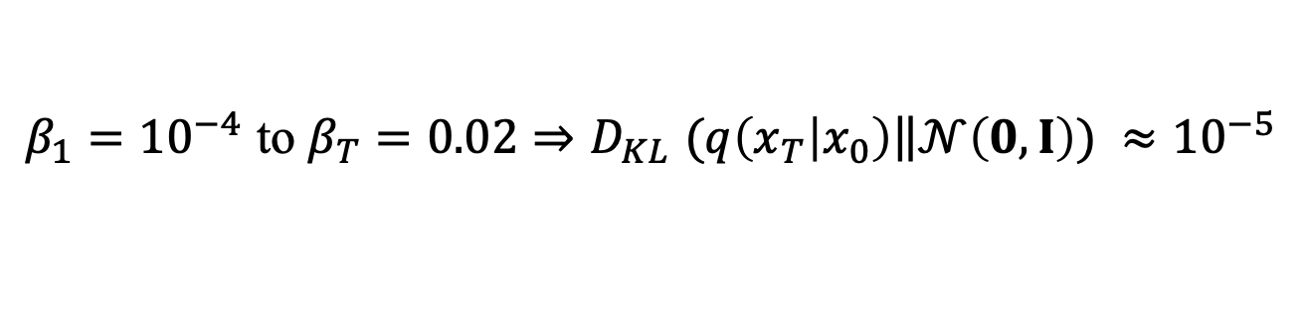
Training & Sampling algorithms
Setting
$$T=1000$$
$β_{1}={10}^{−4}$ to $β_{T}=0.02{⇒D}_{KL}(q\left(x_{T} | x_{0}\right)\left\|𝒩\left(0,I\right)\right.) ≈{10}^{−5}$
$μ_{θ}\left(x_{t},t\right)$: U-Net

Slide 13
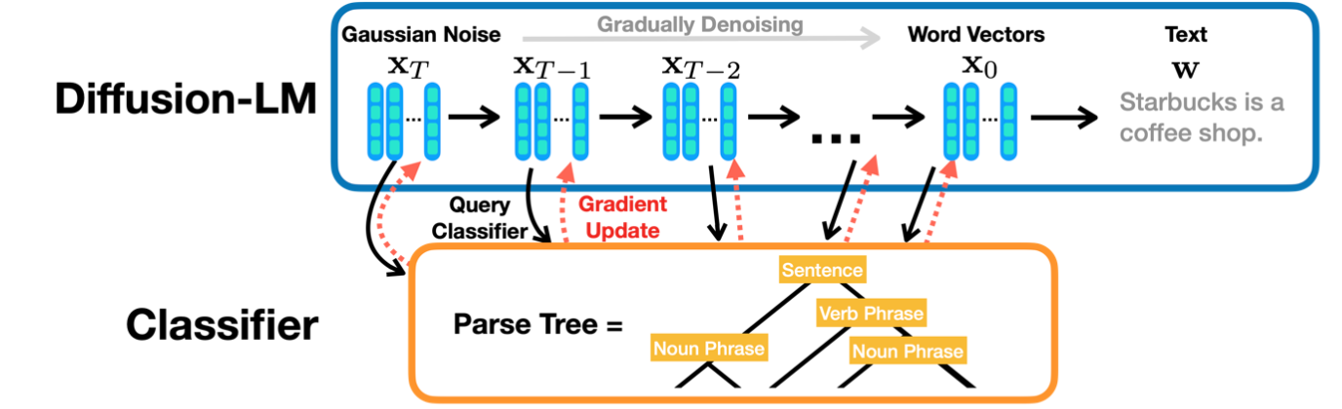
Applications
(Conditioned/Controllable Generation)
[NLP] Test Generation
Li et al. Diffusion-LM Improves Controllable Text Generation, NIPS 2023

Slide 14
Applications
[Vision] (Controllable) Image Generation
Text-to-image generation: DALL-E 2
Image-to-image translation
Image restoration: DDRM
…
[Graph] Molecule Generation
Xu et al. GEODIFF: A GEOMETRIC DIFFUSION MODEL FOR MOLECULAR CONFORMATION GENERATION, ICLR 2022

Slide 15
Quick Summary
Pros:
Tractability and flexibility
High quality
Cons:
Expensive and inefficiency (Depends on a long Markov chain of diffusion steps)
Inconvenience on discrete data

Slide 16
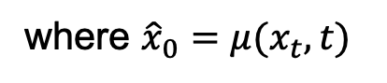
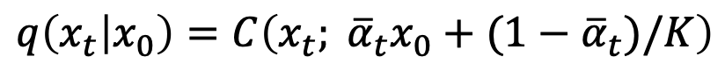
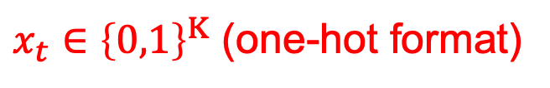
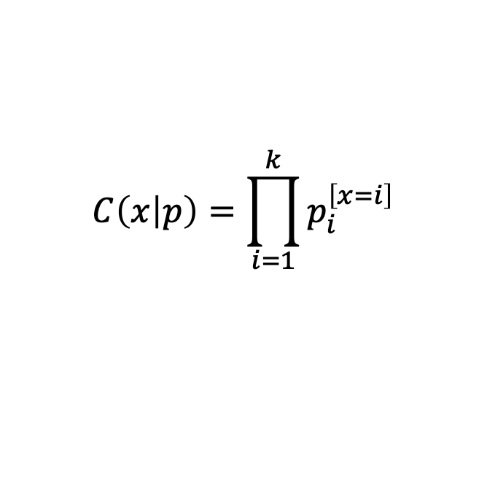
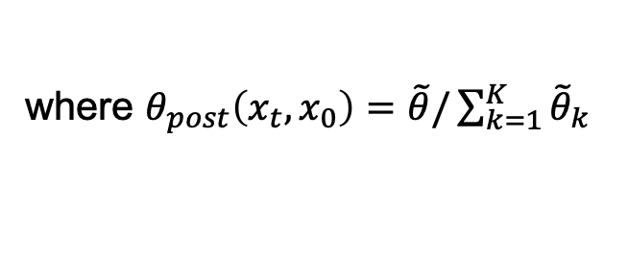
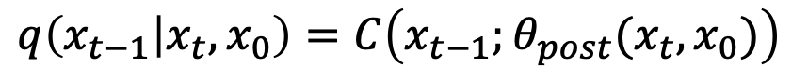
Works on discrete data (categorical data)
Multinomial Diffusion
$x_{t}∈{\left\{0,1\right\}}^{K}$ (one-hot format)
$$C\left(x | p\right)=\prod_{i=1}^{k}{p_{i}^{\left[x=i\right]}}$$
Forward process
$$q\left(x_{t} | x_{t−1}\right)=C\left(x_{t};\left(1−β_{t}\right)x_{t−1}+β_{t}/K\right)$$
$$q\left(x_{t} | x_{0}\right)=C\left(x_{t}; {{\overline{α}}_{t}x}_{0}+(1−{\overline{α}}_{t})/K\right)$$
$$q\left(x_{t−1} | x_{t},x_{0}\right)=C\left(x_{t−1};θ_{post}(x_{t},x_{0})\right)$$
where $θ_{post}\left(x_{t},x_{0}\right)=\tilde{θ}/\sum_{k=1}^{K}{{\tilde{θ}}_{k}}$
and $\tilde{θ}=[α_{t}x_{t}+(1−α_{t})/K]⊙[{\overline{α}}_{t−1}x_{0}+(1−{\overline{α}}_{t−1})/K]$
$p\left(x_{0} | x_{1}\right)=C\left(x_{0};{\hat{x}}_{0}\right)$ and $p\left(x_{t−1} | x_{t}\right)=C\left(x_{t−1};θ_{post}(x_{t}, {\hat{x}}_{0})\right)$
where ${\hat{x}}_{0}=μ(x_{t},t)$
Then we can calculate the KL terms:
$$D_{KL}\left(q\left(x_{t} | x_{t−1},x_{0}\right)∥p_{θ}\left(x_{t−1} | x_{t}\right)\right)=D_{KL}\left(C\left(x_{t−1};θ_{post}(x_{t},x_{0})\right)∥C\left(x_{t−1};θ_{post}(x_{t}, {\hat{x}}_{0})\right)\right)$$
Hoogeboom et al. Argmax Flows and Multinomial Diffusion: Learning Categorical Distributions, NIPS 2021

Slide 17
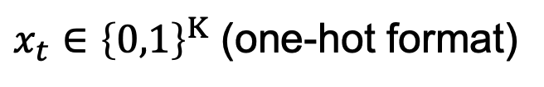
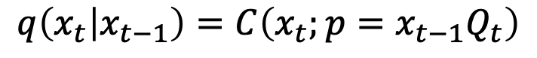
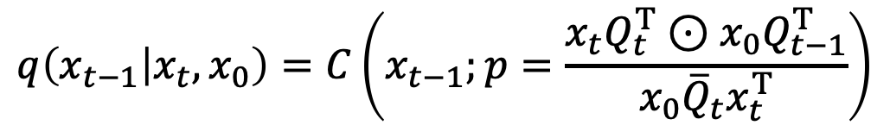
Works on discrete data (categorical data)
DP3M
$x_{t}∈{\left\{0,1\right\}}^{K}$ (one-hot format)
Forward process
$$q\left(x_{t} | x_{t−1}\right)=C\left(x_{t};p=x_{t−1}Q_{t}\right)$$
$q\left(x_{t} | x_{0}\right)=C\left(x_{t};p=x_{0}{\overline{Q}}_{t}\right)$, with ${\overline{Q}}_{t}=Q_{1}Q_{2}…Q_{t}$
$$q\left(x_{t−1} | x_{t},x_{0}\right)=C\left(x_{t−1};p=\frac{x_{t}Q_{t}^{T}⊙x_{0}Q_{t−1}^{T}}{x_{0}{\overline{Q}}_{t}x_{t}^{T}}\right)$$
Noise schedules
Uniform
Absorbing state (MASK)
Discretized Gaussian
...
Austin et al. Structured Denoising Diffusion Models in Discrete State-Spaces NIPS 2021

Slide 18
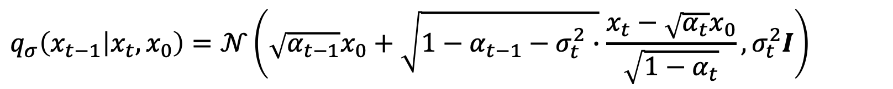
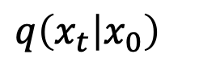
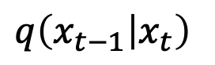







Works on Speeding up sampling (DDIM)
derivate
derivate
approximate
DDPM:
$$q\left(x_{t} | x_{t−1}\right)$$
$$q\left(x_{t} | x_{0}\right)$$
$$q\left(x_{t−1} | x_{t},x_{0}\right)$$
$$q\left(x_{t−1} | x_{t}\right)$$
Loss
Sampling
$${L_{t−1}=D}_{KL}\left(q\left(x_{t} | x_{t−1},x_{0}\right)∥p_{θ}\left(x_{t−1} | x_{t}\right)\right)$$
$$q\left(x_{t} | x_{0}\right)$$
$$\int{q\left(x_{t−1} | x_{t},x_{0}\right)q\left(x_{t} | x_{0}\right)}dx_{t}=q\left(x_{t−1} | x_{0}\right)$$
$$q\left(x_{t−1} | x_{t}\right)$$
$$q_{σ}\left(x_{1:T} | x_{0}\right)≔q_{σ}\left(x_{T} | x_{0}\right)\prod_{t=2}^{T}{q_{σ}\left(x_{t−1} | x_{t},x_{0}\right)}$$
where $q_{σ}\left(x_{T} | x_{0}\right)=𝒩\left(\sqrt{α_{T}}x_{0},\left(1−α_{T}\right)I\right)$
Ensure that $q_{σ}\left(x_{t} | x_{0}\right)=𝒩\left(x_{t};\sqrt{α_{t}}x_{0},\left(1−α_{t}\right)I\right)$
$$q_{σ}\left(x_{t−1} | x_{t},x_{0}\right)=𝒩\left(\sqrt{α_{t−1}}x_{0}+\sqrt{{1−α}_{t−1}−σ_{t}^{2}∙}\frac{x_{t}−\sqrt{α_{t}}x_{0}}{\sqrt{{1−α}_{t}}},σ_{t}^{2}I\right)$$
Song et al. DENOISING DIFFUSION IMPLICIT MODELS, ICLR 2021

Slide 19








Works on Speeding up sampling (DDIM)
$$f_{θ}^{(t)}\left(x_{t}\right)≔\frac{1}{\sqrt{α_{t}}}(x_{t}−\sqrt{1−α_{t}}ε_{θ}^{(t)}(x_{t}))$$
$$p_{θ}^{\left(t\right)}\left(x_{t−1} | x_{t}\right)=\left\{\begin{aligned}𝒩\left(f_{θ}^{(t)}\left(x_{t}\right),σ_{1}^{2}I\right) \\ q_{σ}\left(x_{t−1} | x_{t},f_{θ}^{\left(t\right)}\left(x_{t}\right)\right)\end{aligned}\right.$$
if $t=1$
otherwise
Train process:${\left\|ε−ε_{θ}(\sqrt{{\overline{α}}_{t}}x_{0}+\sqrt{1−{\overline{α}}_{t}}ε,t)\right\|}^{2}$
$$x_{t−1}=\sqrt{α_{t−1}}\left(\frac{x_{t}−\sqrt{1−α_{t}}ε_{θ}^{(t)}(x_{t})}{\sqrt{α_{t}}}\right)+\sqrt{{1−α}_{t−1}−σ_{t}^{2}}∙ε_{θ}^{\left(t\right)}\left(x_{t}\right)+σ_{t}ε_{t}$$
$$τ=\left[τ_{1},τ_{2},…,τ_{S−1},τ_{S}\right],τ_{S}=T, \overline{τ}≔\{1,…T\}\backslash τ$$
Inference process: $q_{σ,τ}\left(x_{1:T} | x_{0}\right)≔q_{σ,τ}\left(x_{τ_{S}} | x_{0}\right)\prod_{i=1}^{S}{q_{σ,τ}\left(x_{τ_{i−1}} | x_{τ_{i}},x_{0}\right)\prod_{t∈\overline{τ}}{q_{σ,τ}\left(x_{t} | x_{0}\right)}}$
$$q_{σ,τ}\left(x_{τ_{i}−1} | x_{τ_{i}},x_{0}\right)=𝒩\left(x_{t};\sqrt{α_{τ_{i}−1}}x_{0}+\sqrt{{1−α}_{τ_{i}−1}−σ_{τ_{i}}^{2}∙}\frac{x_{τ_{i}}−\sqrt{α_{τ_{i}}}x_{0}}{\sqrt{{1−α}_{τ_{i}}}},σ_{τ_{i}}^{2}I\right)$$
Generative process: $p_{θ}(x_{0:T})≔p_{θ}(x_{T})\prod_{i=1}^{S}{p_{θ}^{(τ_{i})}\left(x_{τ_{i−1}} | x_{τ_{i}}\right)×\prod_{t∈\overline{τ}}{p_{θ}^{\left(t\right)}(x_{0}|x_{t})}}$
Use to produce samples
In variational objective

Slide 20




Simple Derivation (DDIM)
$$x_{t−1}=\sqrt{α_{t−1}}\left(\frac{x_{t}−\sqrt{1−α_{t}}ε_{θ}^{(t)}(x_{t})}{\sqrt{α_{t}}}\right)+\sqrt{{1−α}_{t−1}−σ_{t}^{2}}∙ε_{θ}^{\left(t\right)}\left(x_{t}\right)+σ_{t}ε_{t}$$
When${ σ}_{t}=g\left(α_{t},α_{t−1}\right)⟹$ DDPM
${ σ}_{t}=0⟹$ deterministic decoding $⟹$ Denoising Diffusion Implicit Model (DDIM)
Interpolation
$\frac{x_{t−Δt}}{\sqrt{α_{t−Δt}}}=\frac{x_{t}}{\sqrt{α_{t}}}+(\sqrt{\frac{1−α_{t−Δt}}{α_{t−Δt}}}−\sqrt{\frac{1−α_{t}}{α_{t}}})ε_{θ}^{\left(t\right)}\left(x_{t}\right)$
$$dx_{t}=ε_{θ}^{\left(t\right)}\left(\frac{x_{t}}{\sqrt{σ^{2}+1}}\right)dσ_{t}⟹ODE$$

Slide 21
Score-Based Model
Xinyang Liu
Xidian University

Slide 22





Statistical foundations of generative models
Example
First pixel
Model family
$$p_{μ,σ}\left(x\right)=𝒩(x|μ,σ^{2})$$
121
137
$$p_{data}(x)$$
108
$$X_{1},X_{2},…,X_{N}$$
Data points
149

Slide 23

Statistical foundations of generative models
Example
First pixel
Model family
$$p_{μ,σ}\left(x\right)=𝒩(x|μ,σ^{2})$$
121
$$p_{μ^{∗},σ^{∗}}\left(x\right)≈p_{data}(x)$$
Generative models
137
108
$${\hat{X}}_{1},{\hat{X}}_{2},{\hat{X}}_{3},…∼p_{μ^{∗},σ^{∗}}\left(x\right)$$
Data points
149

Slide 24
Statistical foundations of generative models
Example
First pixel
Model family
$$p_{μ,σ}\left(x\right)=𝒩(x|μ,σ^{2})$$
121
Generative models
137
108
149

Slide 25




Statistical foundations of generative models
Well studied in statistical inference & density estimation:
Maximum likelihood estimation (Ronald Fisher 1912-1922)
Method of moments (Chebyshev 1887)
Pseudo-likelihood maximization (Besag 1975)
New challenges in modeling high dimensional data:
$$x_{1}$$
$$p(x_{1})$$

Slide 26








Statistical foundations of generative models
Well studied in statistical inference & density estimation:
Maximum likelihood estimation (Ronald Fisher 1912-1922)
Method of moments (Chebyshev 1887)
Pseudo-likelihood maximization (Besag 1975)
New challenges in modeling high dimensional data:
$$x_{2}$$
$$p(x_{1})$$
$$x_{1}$$
$$p(x_{2}|x_{1})$$

Slide 27





Statistical foundations of generative models
Well studied in statistical inference & density estimation:
Maximum likelihood estimation (Ronald Fisher 1912-1922)
Method of moments (Chebyshev 1887)
Pseudo-likelihood maximization (Besag 1975)
New challenges in modeling high dimensional data:
$$x_{2}$$
$$x_{3}$$
$$x_{1}$$

Slide 28

Statistical foundations of generative models
Well studied in statistical inference & density estimation:
Maximum likelihood estimation (Ronald Fisher 1912-1922)
Method of moments (Chebyshev 1887)
Pseudo-likelihood maximization (Besag 1975)
New challenges in modeling high dimensional data:
$$x_{2}$$
$$x_{3}$$
$$x_{1}$$
Curse of dimensionality

Slide 29


Towards more expressive generative models
$$X$$
$$𝒩(x|μ,σ^{2})$$

Slide 30


Towards more expressive generative models
$$𝒩(X|μ_{1},σ_{1}^{2})$$
$$X$$
$$𝒩(X|μ_{2},σ_{2}^{2})$$

Slide 31
Towards more expressive generative models
$$X$$

Slide 32
Towards more expressive generative models
…
Deep Neural Network
$$X$$
Deep Generative Models

Slide 33





Towards more expressive generative models
…
$$f_{θ}(X)$$
$$e^{{−f}_{θ}(X) }$$
$$\frac{e^{{−f}_{θ}(X) } }{Z_{θ}}=p_{θ}(x)$$
$$X$$
Partition function
$$Z_{θ}=\iint{…\int{e^{{−f}_{θ}\left(x\right) }}dx_{1}dx_{2}…dx_{d}}$$

Slide 34

Towards more expressive generative models
…
$$f_{θ}(X)$$
$$e^{{−f}_{θ}(X) }$$
$$\frac{e^{{−f}_{θ}(X) } }{Z_{θ}}=p_{θ}(x)$$
$$X$$
Partition function
Approximation the Partition function:
Variational auto-encoders (Kingma & Welling 2014, Rezende et al. 2014)
Contrastive divergence (Hinton 2002)
$$Z_{θ}=\iint{…\int{e^{{−f}_{θ}\left(x\right) }}dx_{1}dx_{2}…dx_{d}}$$
Using restricted model architectures:
Autoregressive models (Bengio & Bengio 2000)
Normalizing flow models (Dinh et al. 2014)

Slide 35








Bypassing the partition function
$$p(x)$$
$$∇_{x}\log{p(x)}$$
Density function
(Stein 1986) Score function
$$p_{θ}\left(x\right)=\frac{e^{{−f}_{θ}(X) } }{Z_{θ}}$$
$$∇_{x}\log{p_{θ}=−∇_{x}f_{θ}\left(x\right)−∇_{x}\log{Z_{θ}}}$$
$$=−∇_{x}f_{θ}\left(x\right)$$

Slide 36





How to estimate score function
Given: i.i.d. samples $\left\{x_{1},x_{2},…x_{N}\right\}\sim p_{data}\left(x\right)$
Goal: Estimating the score $∇_{x}\log{p_{data}(x)}$
Score Model: A trainable vector-valued function $s_{θ}\left(x\right):ℝ^{D}→ℝ^{D}$
Objective: How to compare two vector fields of score?
$$\frac{1}{2}𝔼p_{data}\left(x\right)[{\left\|∇_{x}\log{p_{data}\left(x\right)}−s_{θ}\left(x\right)\right\|}_{2}^{2}]$$
(Fisher divergence)
Integration by parts → Score Matching (Hyvärinen 2005)
$$𝔼p_{data}\left(x\right)[{\frac{1}{2}\left\|s_{θ}\left(x\right)\right\|}_{2}^{2}+trace(∇_{x}s_{θ}\left(x\right))]$$
$$≈\frac{1}{N}\sum_{i=1}^{N}{{\frac{1}{2}\left\|s_{θ}\left(x_{i}\right)\right\|}_{2}^{2}+trace(∇_{x}s_{θ}\left(x_{i}\right))]}$$
Not scalable

Slide 37



Sliced score matching
Intuition: one dimensional problems should be easier
$${v^{T}∇}_{x}s_{θ}\left(x\right)v={v^{T}∇}_{x}{{(v}^{T}s}_{θ}\left(x\right))$$
Idea: project onto random directions
Randomized objective: Sliced Fisher Divergence
$$\frac{1}{2}𝔼_{p_{v}}𝔼p_{data}\left(x\right)[{\left\|{v^{T}∇}_{x}\log{p_{data}\left(x\right)}−v^{T}s_{θ}\left(x\right)\right\|}_{2}^{2}]$$
Integration by parts → Sliced Score Matching
$$𝔼_{p_{v}}𝔼p_{data}\left(x\right)[{v^{T}∇}_{x}s_{θ}\left(x\right)v+\frac{1}{2}{\left(v^{T}s_{θ}\left(x\right)\right)}^{2}]$$
Scalable!
Yang Song et al. Sliced Score Matching: A Scalable Approach to Density and Score Estimation, UAI 2019 Oral

Slide 38



Score-based generative modeling
$${s_{θ}\left(x\right)≈∇}_{x}\log{p_{data}\left(x\right)}$$
Scores
Follow the scores
$$s_{θ}\left(x\right)$$

Slide 39


Score-based generative modeling
$${s_{θ}\left(x\right)≈∇}_{x}\log{p_{data}\left(x\right)}$$
Scores
Follow the scores
Follow noisy scores: Langevin dynamics
(Parisi 1981)
$$s_{θ}\left(x\right)$$

Slide 40



Langevin dynamics
$$x_{0}\sim π(x)$$
$$x_{i+1}←x_{i}+ε∇_{x}\log{p\left(x\right)+\sqrt{2ε}z_{i}, i=0,1,…K}$$
$$z_{i}\sim 𝒩\left(0,I\right)$$
$ε→0 and K→∞$ converge

Slide 41

Naive score-based generative modeling
Model samples

Slide 42

Challenge in low data density regions

Slide 43

Improving score estimation by add noise

Slide 44



Using multiple noise scales
Data
$$\sum_{i=1}^{N}{λ(i)𝔼p_{σ_{i}}\left(x\right)[{\left\|∇_{x}\log{p_{σ_{i}}\left(x\right)}−s_{θ}\left(x,i\right)\right\|}_{2}^{2}]}$$
Noise Conditional Score Networks (NCSN)
Yang Song et al. Generative Modeling by Estimating Gradients of the Data Distribution, NIPS 2019 Oral

Slide 45

Using multiple noise scales
Data
Noise Conditional Score Networks (NCSN)
Yang Song et al. Generative Modeling by Estimating Gradients of the Data Distribution, NIPS 2019 Oral

Slide 46
Using multiple noise scales
Data
Annealed Langevin dynamics
Noise Conditional Score Networks (NCSN)

Slide 47

Annealed Langevin dynamics for the Noise Conditional Score Network (NCSN) model
Trained on CelebA
Trained on CIFAR-10
(Beat GANs for the first time)

Slide 48





High resolution image generation
$$256×256$$
$$128×128$$
$$96×96$$
$$64×64$$

Slide 49



Infinitely many noise scales

Slide 50

Infinitely many noise scales

Slide 51




Infinitely many noise scales
$$p_{0}\left(x\right)$$
$$=$$
$$p_data(x)$$
$$p_{T}\left(x\right)$$
$$p_{t}\left(x\right)$$
$$t∈\left[0,T\right]:continuous index of perturbed distributions$$

Slide 52



Perturbing data with an SDE
Stochastic process ${\left\{x\left(t\right)\right\}}_{t=0}^{T}→$ Marginal probability densities ${\left\{p_{t}\left(x\right)\right\}}_{t=0}^{T}$
Stochastic differential equation: $dx=f\left(x,t\right)dt+σ\left(t\right)dw$
$$dx=σ\left(t\right)dw$$

Slide 53






Score-based generative modeling via SDEs
$$π\left(x\right)≈p_{T}(x)$$
$$p_{θ}(x)$$
$$dx=σ\left(t\right)dw$$
$$dx=−σ^{2}(t)∇_{x}\log{p_{t}\left(x\right)dt}+σ\left(t\right)dw$$
Time reversal
Score function!

Slide 54

Score-based generative modeling via SDEs
Time-dependent score model:
$${s_{θ}\left(x,t\right)≈∇}_{x}\log{p_{t}\left(x\right)}$$
Training:
$$𝔼_{t\sim Uniform[0,T]}[λ\left(t\right)𝔼_{p_{t}\left(x\right)}[{\left\|∇_{x}\log{p_{t}\left(x\right)}−s_{θ}\left(x,t\right)\right\|}_{2}^{2}]$$
Reverse-time SDE:
$$dx=−σ^{2}(t)s_{θ}\left(x,t\right)dt+σ\left(t\right)dw$$
Numerical SDE solver for sample generation.
Unifies diffusion probabilistic models into the framework of score-based generative models
Yang Song et al. SCORE-BASED GENERATIVE MODELING THROUGH STOCHASTIC DIFFERENTIAL EQUATIONS, ICML 2021 Oral, Outstanding paper

Slide 55
Reference
DDPM and its extension:
DDPM: Jouathan Ho et al. Denoising Diffusion Probabilistic Models, ICML 2020 (UCB)
DDIM: Jiaming Song et al. DENOISING DIFFUSION IMPLICIT MODELS, ICLR 2021 (Stanford, Ermon’s group)
Multinomial Diffusion: Emiel Hoogeboom et al. Argmax Flows and Multinomial Diffusion: Learning Categorical Distributions NIPS 2021 (Welling’s group)
DP3M: Jacob Austin et al. Structured Denoising Diffusion Models in Discrete State-Spaces, NIPS 2021(Google Research, Brain Team)
Score-based model:
Sliced score matching: Yang Song et al. Sliced Score Matching: A Scalable Approach to Density and Score Estimation, UAI 2019 Oral (Stanford, Ermon’s group)
NCSN: Yang Song et al. Generative Modeling by Estimating Gradients of the Data Distribution, NIPS 2019 Oral (Stanford, Ermon’s group)
Score-based model: Yang Song et al. SCORE-BASED GENERATIVE MODELING THROUGH STOCHASTIC DIFFERENTIAL EQUATIONS, ICML 2021 Oral, Outstanding paper (Stanford, Ermon’s group, Google Brain)
Other interesting works:
Analytic-DPM: Fan Bao et al. Analytic-DPM: an Analytic Estimate of the Optimal Reverse Variance in Diffusion Probabilistic Models, ICLR 2022, Outstanding paper (Tsinghua, Zhu’s group)
CARD: CARD: Xizewen Han et al. Classification and Regression Diffusion Models NIPS 2022(UT, Zhou’s group)
Blog:
https://lilianweng.github.io/posts/2021-07-11-diffusion-models/#nice
https://yang-song.net/blog/2021/score/

Slide 56

Appendix (Derivation-1)

Slide 57

Appendix (Derivation-2)

Slide 58


Appendix (Derivation-3)
$$μ_{θ}→\frac{1}{\sqrt{{\overline{α}}_{t}}}\left(x_{t}−\frac{β_{t}}{\sqrt{1−{\overline{α}}_{t}}}ε\right), given x_{t}$$

Slide 59



Appendix
Uniform diffusion
Diffusion with an absorbing state
Discretized Gaussian transition matrices

Slide 60


Appendix
Illustration of Multinomial Diffusion
Illustration of DP3M

Slide 61

Appendix

Slide 62


Appendix

Slide 63


Appendix

Slide 64

Appendix

Slide 65

Appendix

Slide 66


Appendix

Slide 67


Appendix

Slide 68


Appendix

Slide 69



Appendix
$μ_{θ} \left(x_{t},t\right):$ U-Net
$${Dim}^{input}={Dim}^{output}$$

Slide 70

Appendix
DDPM

